Slide 1

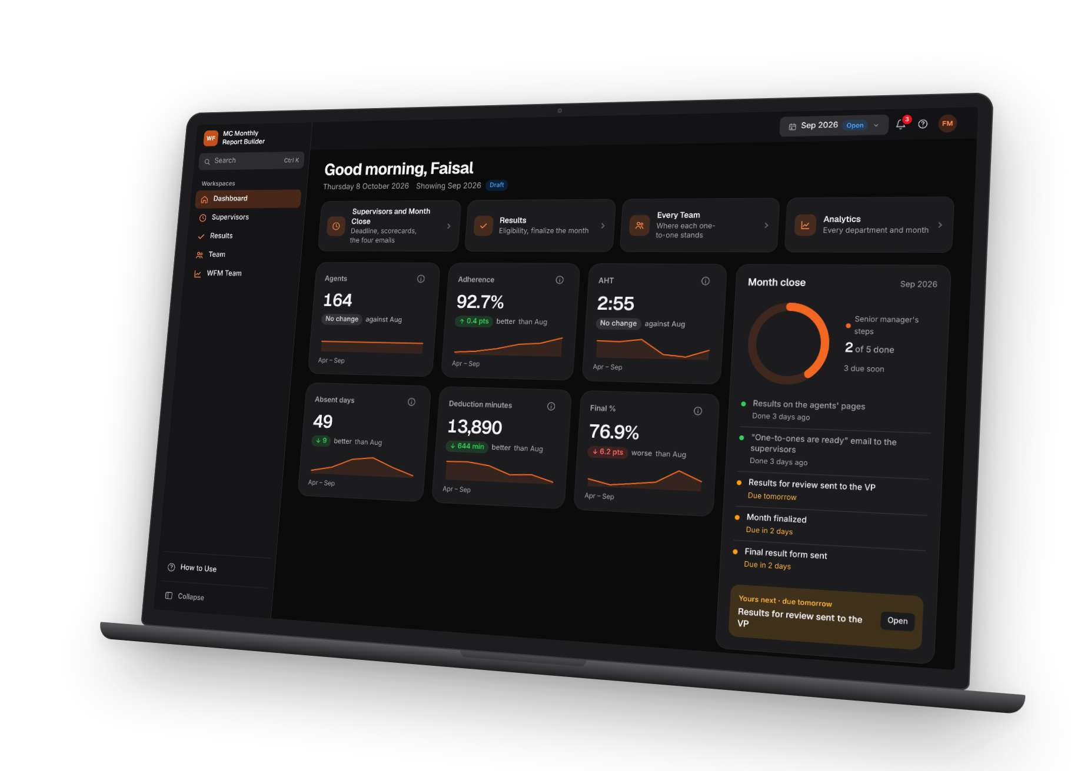
WF
MC Monthly
Report Builder
Workforce management for Member Care: from the month's Genesys exports to the final emails, in one offline file.
One file
Every role
Nothing leaves the company
Member Care · WFM team · October 2026
Notes:
MC Monthly Report Builder: one offline file that turns the month's Genesys exports and the supervisors' attendance into the monthly workbook, the incentive data and the emails, with a page for every role.

Slide 2





Month end was
a manual marathon
THE CHALLENGE
Ten files.
Seven roles.
One deadline.
Files gathered by hand
Four Genesys exports, every supervisor's attendance sheet, the KPI and quality files, joined by copy and paste.
Monthly Adherence.csv
Schedule activities.csv
Numbers hard to explain
Agent Status Timeline.csv
Agents Performance Summary.csv
Bonus and deduction worked out in spreadsheets: a rounding or a missed absence was hard to find, and harder to explain.
Attendance - CT.xlsx
KPI results.xlsx
Emails built one by one
The deduction and incentive emails, their tables and attachments, put together by hand every month.
Final EVAL.xlsx
Incentive data.xlsx
Notes:
Before the tool, month end meant collecting ten or more files and joining them by hand. The numbers behind the bonus and the deduction were hard to check and hard to explain, and every email was built by hand.

Slide 3
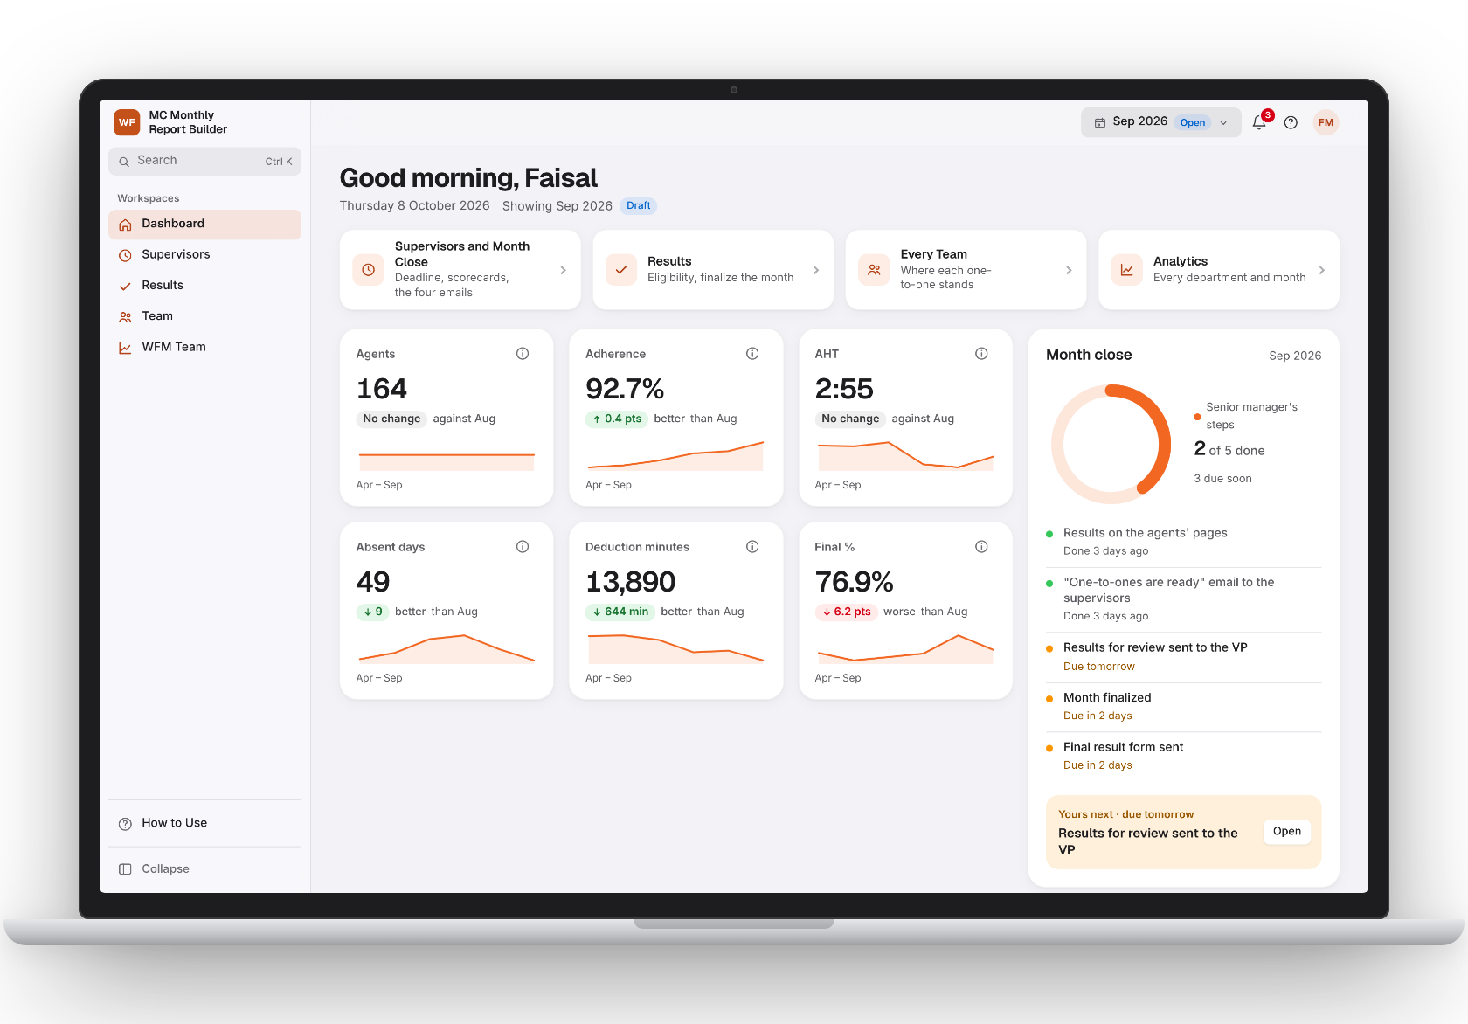




One file.
Your month in one place
THE TOOL
Works offline
Opens in Edge or Chrome: nothing to install, no server.
Shared
Everyone works on the same data folder, next to the HTML.
Locked
The data files are encrypted: only accounts made in the tool read them.
For every role
WFM, supervisors, the senior manager, quality and agents.
Notes:
The tool is a single HTML file kept in the common folder next to the MC Data folder. It works offline, the data is shared and locked, and every role signs in to its own page.

Slide 4
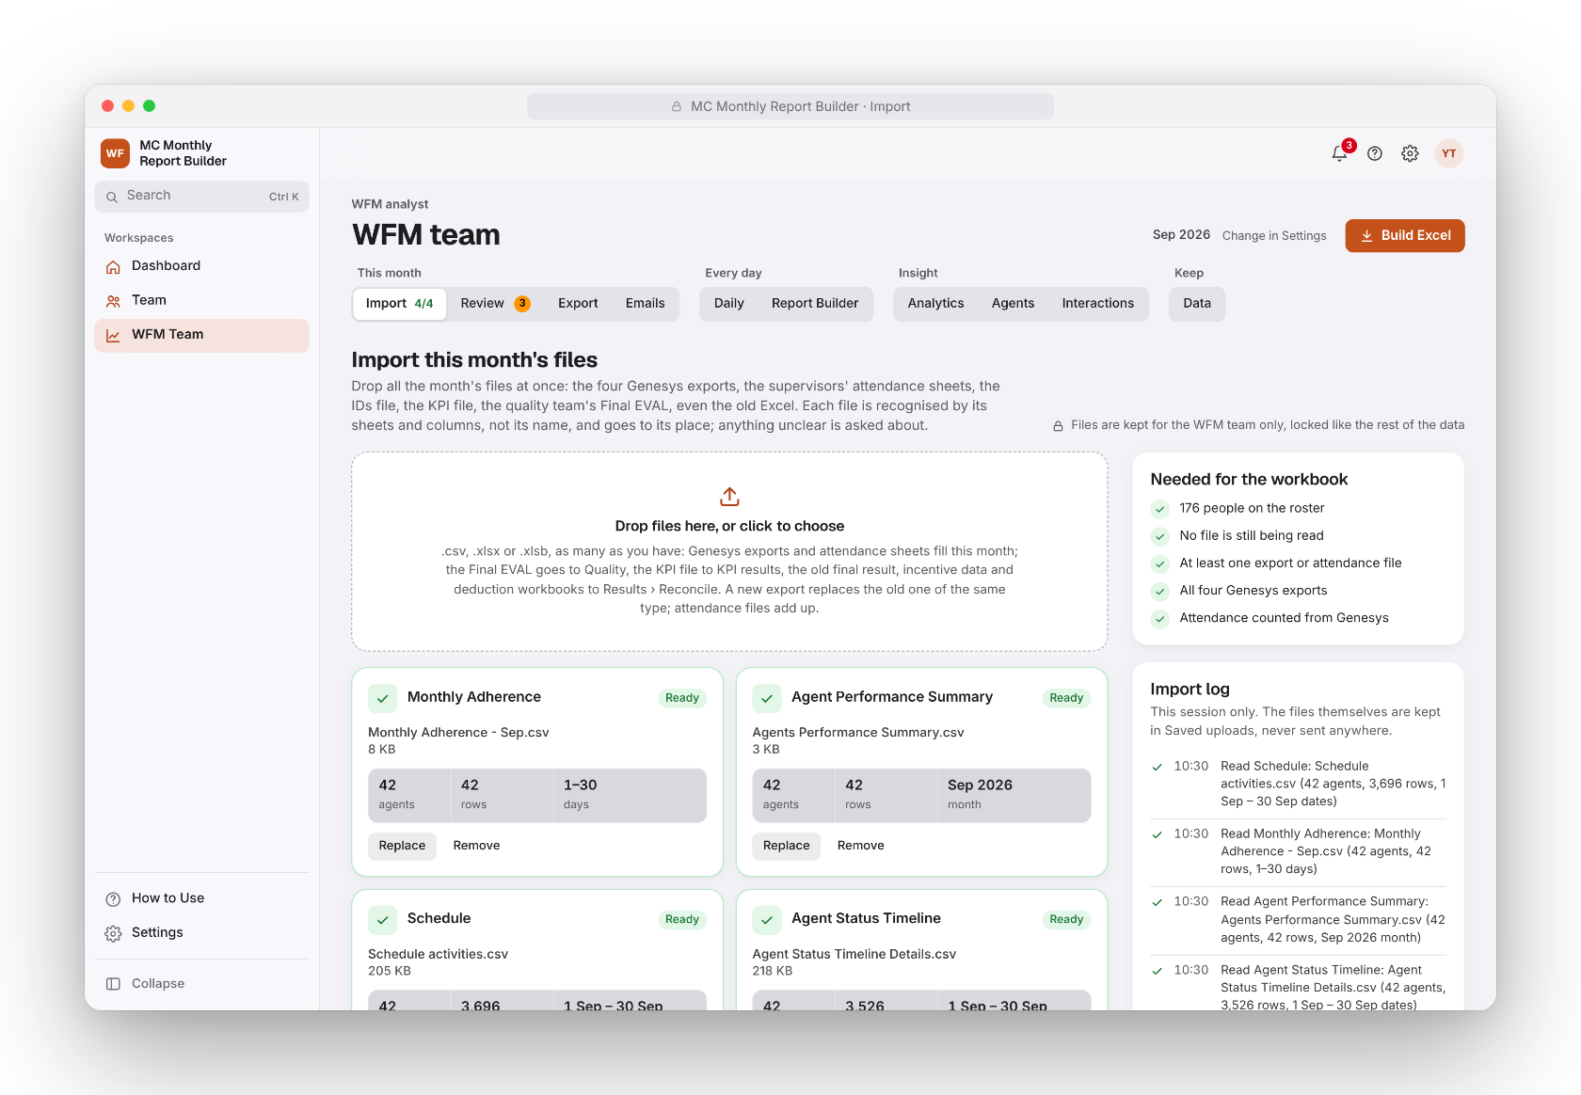
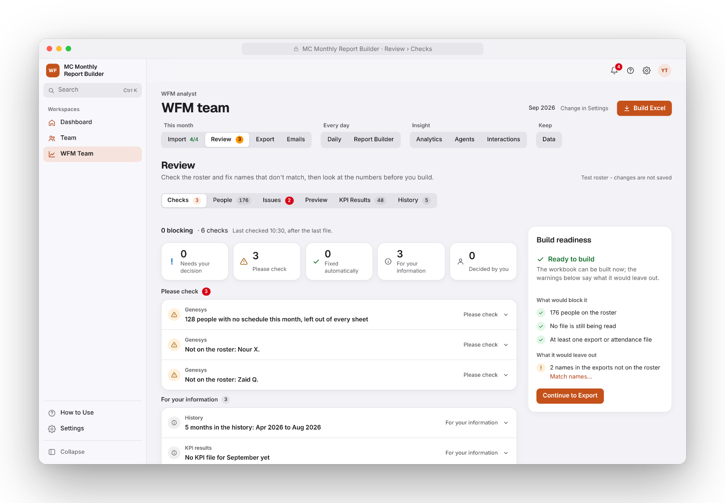
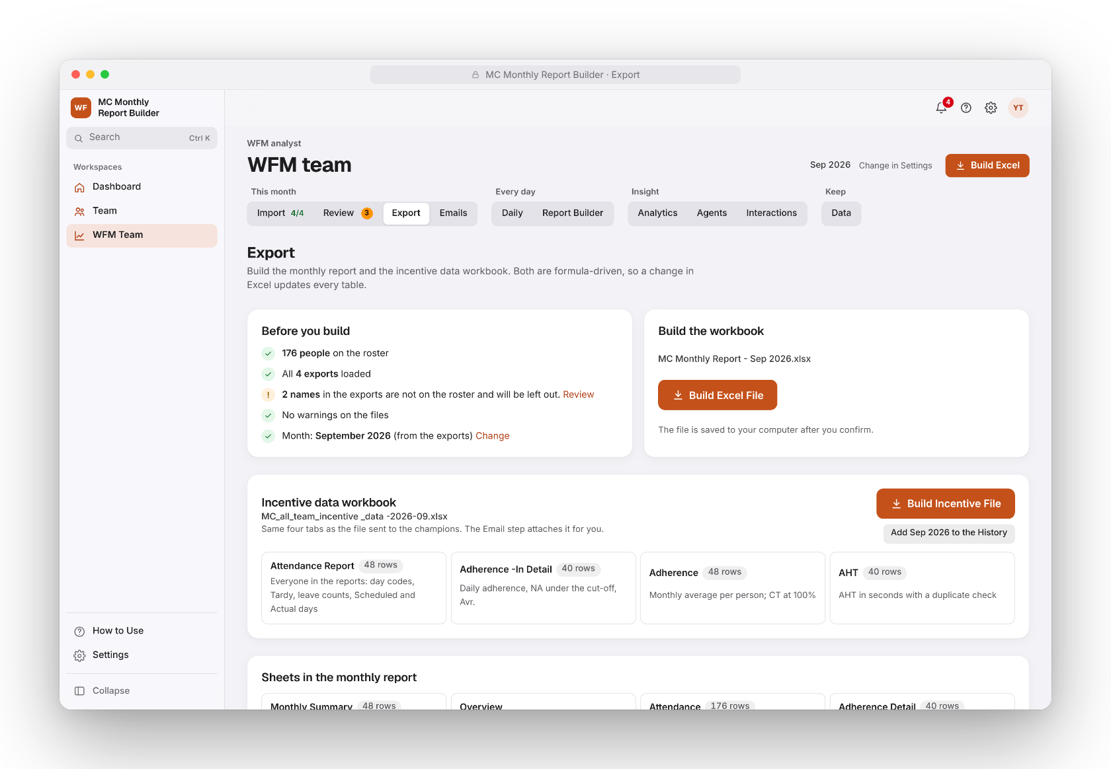
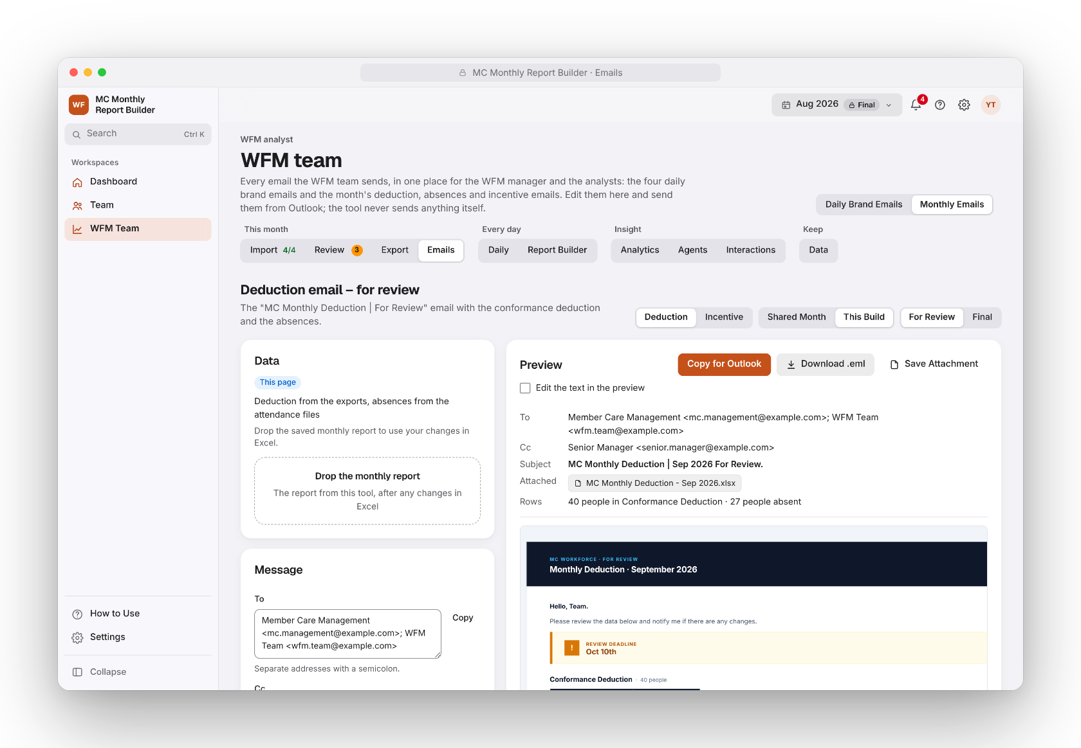
From the exports
to the final emails
HOW A MONTH RUNS
1
Import
2
Review
3
Export
4
Emails
Drop the month's files at once: each one is recognised by its columns.
Checks list what needs a decision: names, duplicates, attendance.
The monthly workbook and the incentive data, kept with the shared data.
Deduction and incentive emails, for review and final, ready for Outlook.
Notes:
A month runs in four steps on the WFM team page: Import the files, Review what the checks found, Export the workbooks, and send the emails. Each step says what it still needs.

Slide 5






Checked
at every step
BUILT TO BE RIGHT
1
4
7
file to open: no install, no server
Genesys exports read in one drop
roles, each with its own page
10,000
21
0
synthetic people checked against the previous engine
automated browser test suites
network calls: no data leaves the computer
Notes:
The counting is checked against the previous engine on ten thousand synthetic people, and the pages are covered by automated browser tests. The tool makes no network call: the data never leaves the computer and the shared folder.

Slide 6
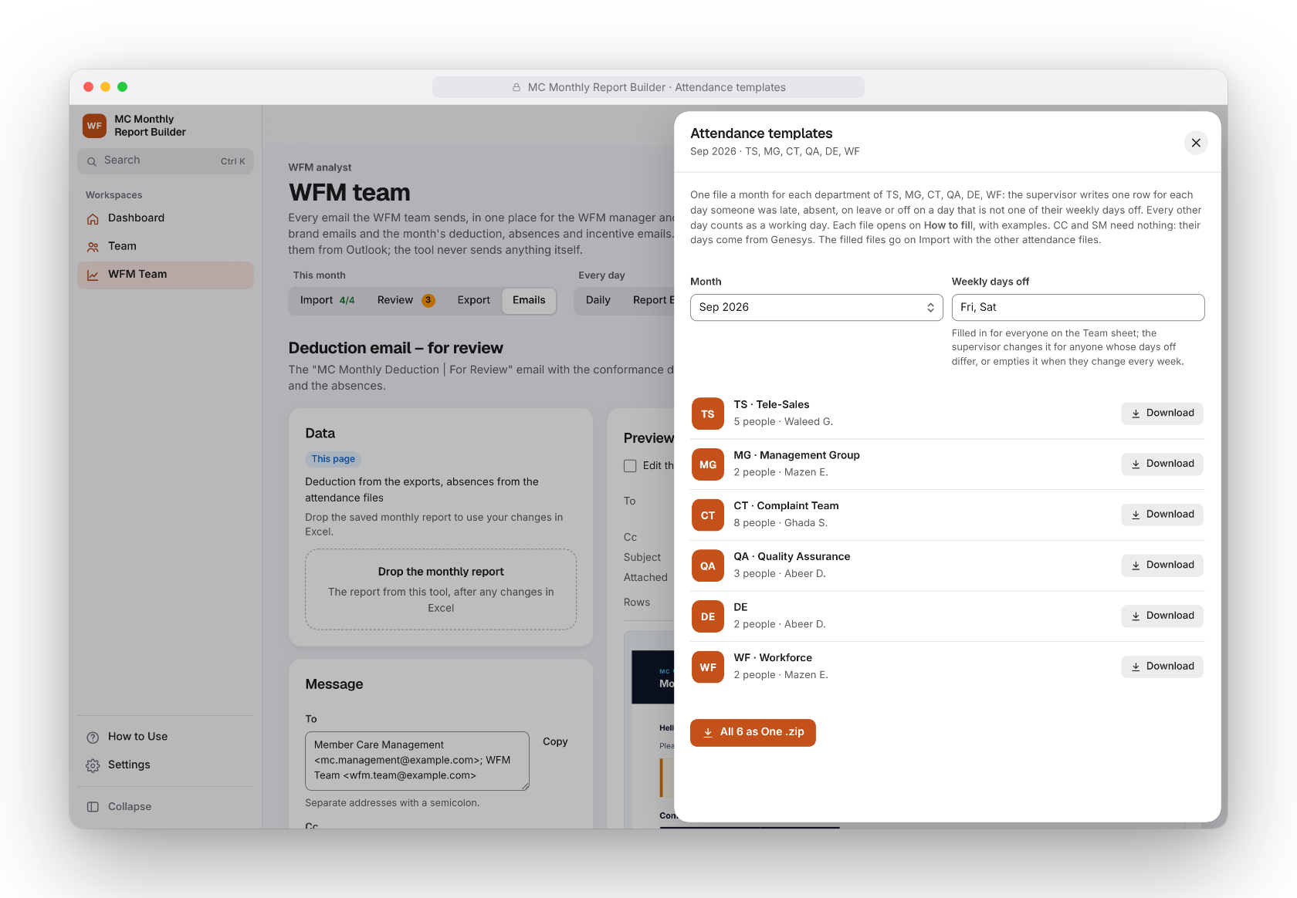

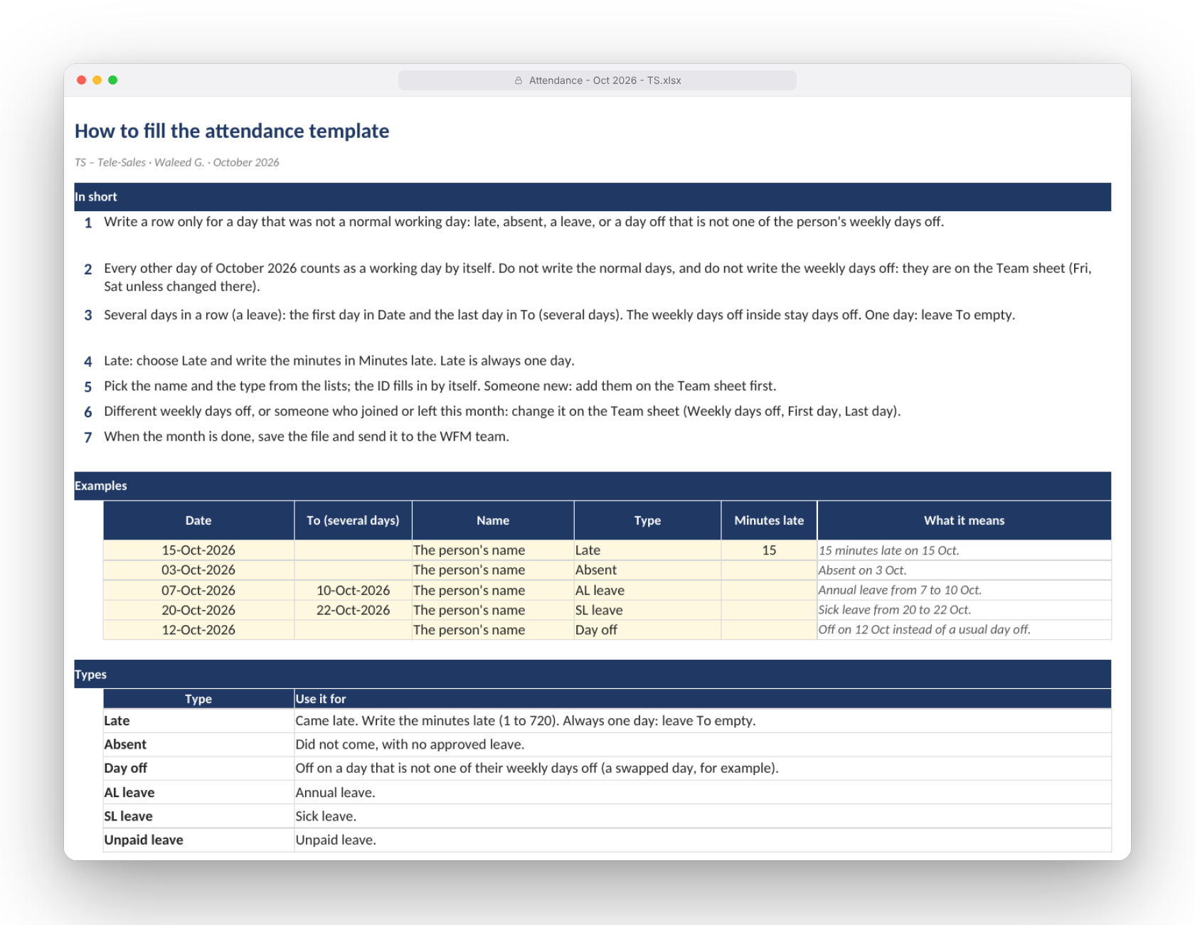


Attendance
without the chase
ATTENDANCE
CC and SM: automatic
Counted from the Schedule and the Agent Status Timeline, the way their supervisors already did in Genesys. Supervisors only correct sick days.
TS, MG, CT, QA, DE, WF: one template
One file a month for each department, made by the tool. Supervisors write only the late, absent, leave and off days: every other day counts as worked.
Opens on How to fill
Examples, the types and tips on the cells, in the same look as the tool's workbooks.
Notes:
CC and SM attendance comes from Genesys by itself. The other departments get one template a month, per department: only the exceptions are written, every other day counts as worked, and each file opens on its own instructions.

Slide 7
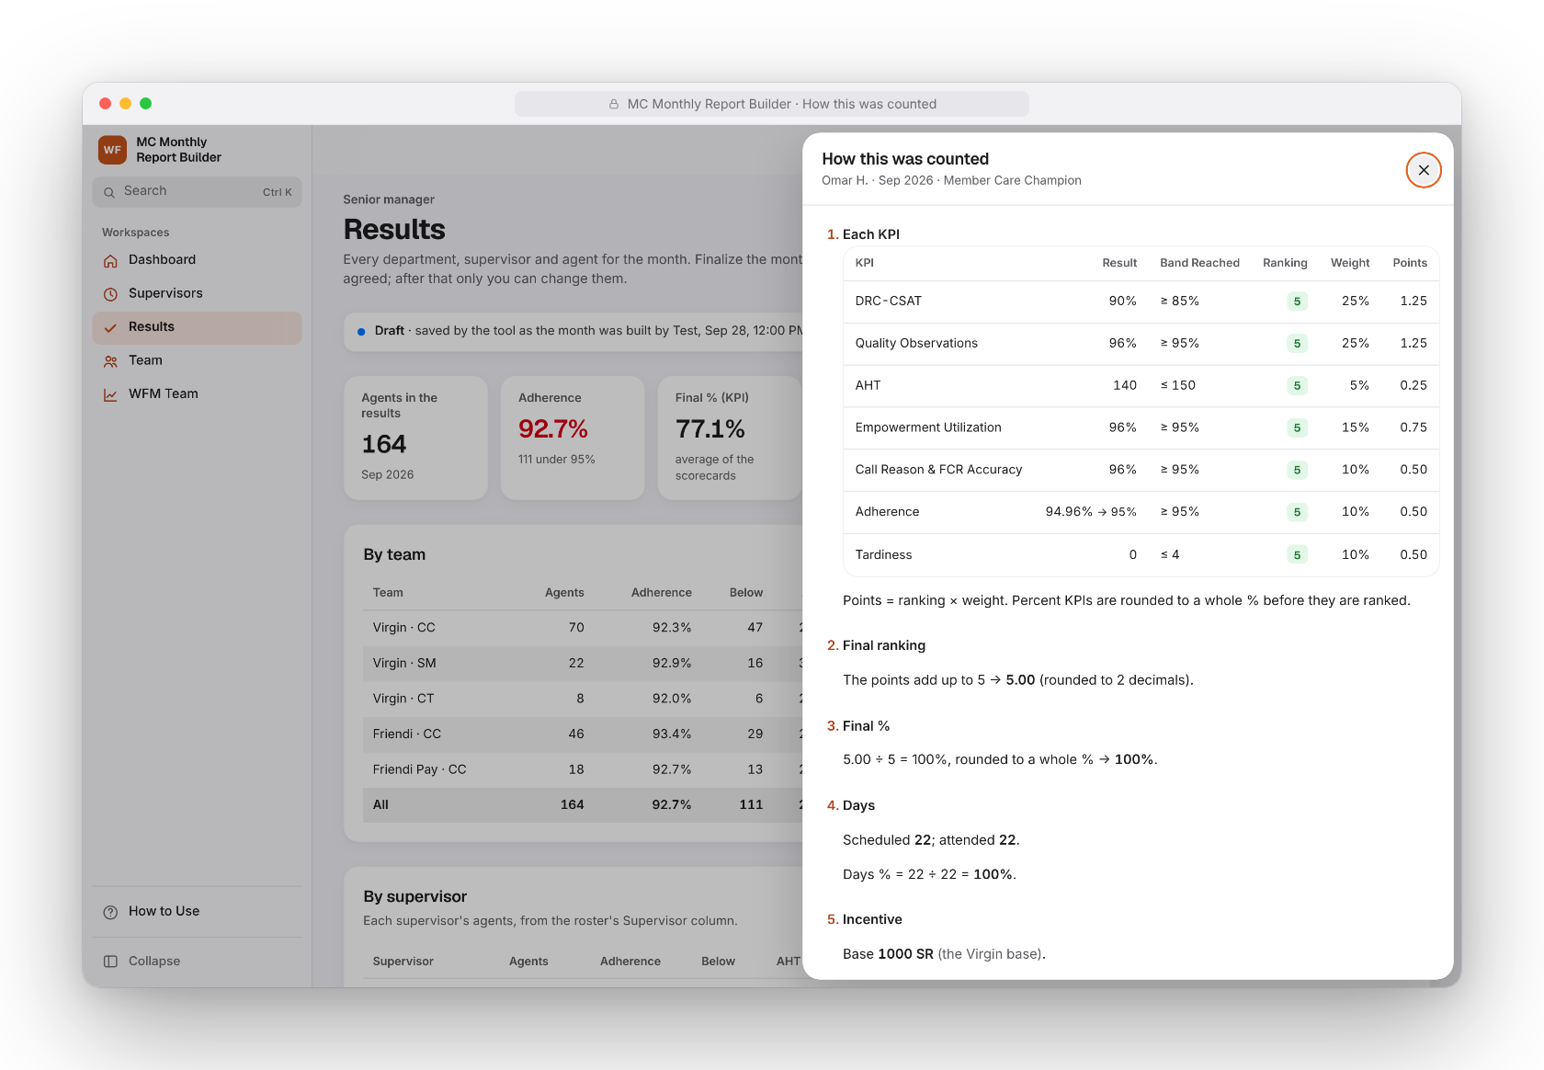




Every bonus,
explained
INCENTIVE
One set of rules
Scorecards, bases and who is eligible, in force from a month; every change logged.
Counted as the old files did
Percent KPIs and the Final % rounded to a whole %: 94.99% counts as 95%.
How this was counted
For every person: each KPI's value, band, ranking and points, the days, and why they earn it or not.
Reconcile with the old Excel
Drop the old workbook: every difference is lined up with its cause and a fix.
Notes:
The incentive is counted from one set of rules, the same way for everyone, and the panel How this was counted shows every step for every person. The old Excel can be dropped in to explain any difference.

Slide 8




Month-end emails,
ready to send
EMAILS
Deduction and incentive
For review and final, from the shared month or this build.
What changed, listed
The final email lists every change since the review.
A private attachment
One workbook with the Attendance Report and the Monthly Deduction, without National IDs.
Sent from Outlook
Copy for Outlook or download the .eml: the tool never sends anything itself.
Notes:
The deduction and incentive emails are made by the tool for review and final. The attachment is built automatically and carries no National IDs. The tool never sends anything: the WFM team sends from Outlook.

Slide 9
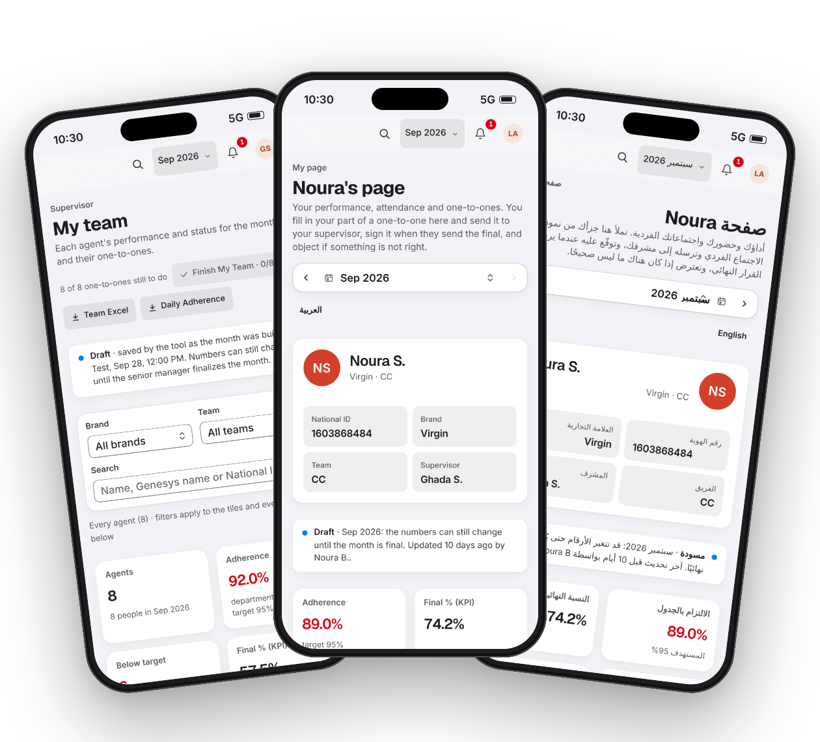

One tool,
a page for every role
EVERY ROLE
WFM analysts
WFM manager
Build the month and the daily reports
Emails, interactions and analytics
Senior manager
Supervisors
Rules, results, the month's four emails
Their team, one-to-ones, attendance
Quality team
Agents
The Final EVAL and critical errors
Their results and forms, in English or Arabic
Notes:
Each role signs in to its own pages: the WFM team builds the month, the senior manager decides and finalizes, supervisors run their team and one-to-ones, the quality team keeps the evaluations, and agents see their own results, in English or Arabic.

Slide 10
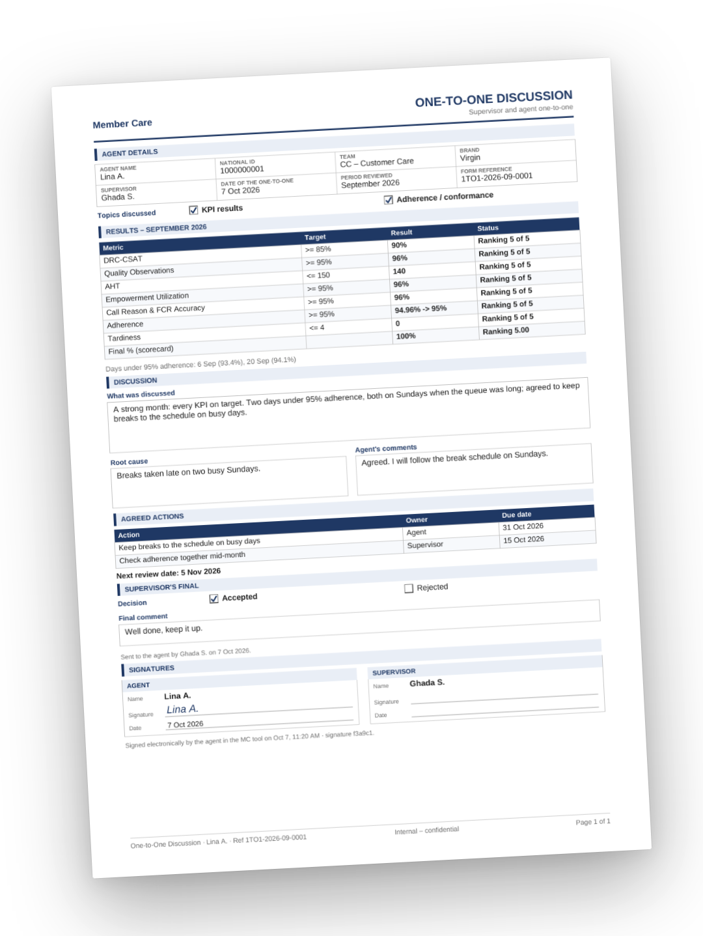



One-to-ones
on one page
COACHING
Ready from the month's numbers
The results, the days under target and last month's actions are filled in.
Agent and supervisor, in turn
The agent adds their part and signs on screen after the supervisor's final.
Follow-up that sticks
Next month's form starts with what was agreed.
Deadlines in the bell
Everyone sees what is theirs to do; the senior manager sees who finished.
Notes:
The one-to-one form is prepared from the month's numbers and fits on one page. The agent fills in their part and signs on screen; next month's form starts with the actions agreed.

Slide 11




Your data
stays yours
PRIVATE BY DESIGN
Locked files
Sign-in and roles
No network
Encrypted in the shared folder (AES-GCM): unreadable outside the tool.
Passwords, roles and approvals; an agent sees only their own page.
The tool sends nothing and calls no server.
No IDs in emails
A locked backup
Every change logged
Email attachments carry names only, never National IDs.
The WFM team exports everything to one file locked with a password.
Adjustments, rules and ticks keep who made them and when.
Notes:
Privacy is built in: the shared files are encrypted, each person signs in with their own role, nothing is sent over the network, email attachments carry no National IDs, and only the WFM team can export the data, locked with a password.

Slide 12
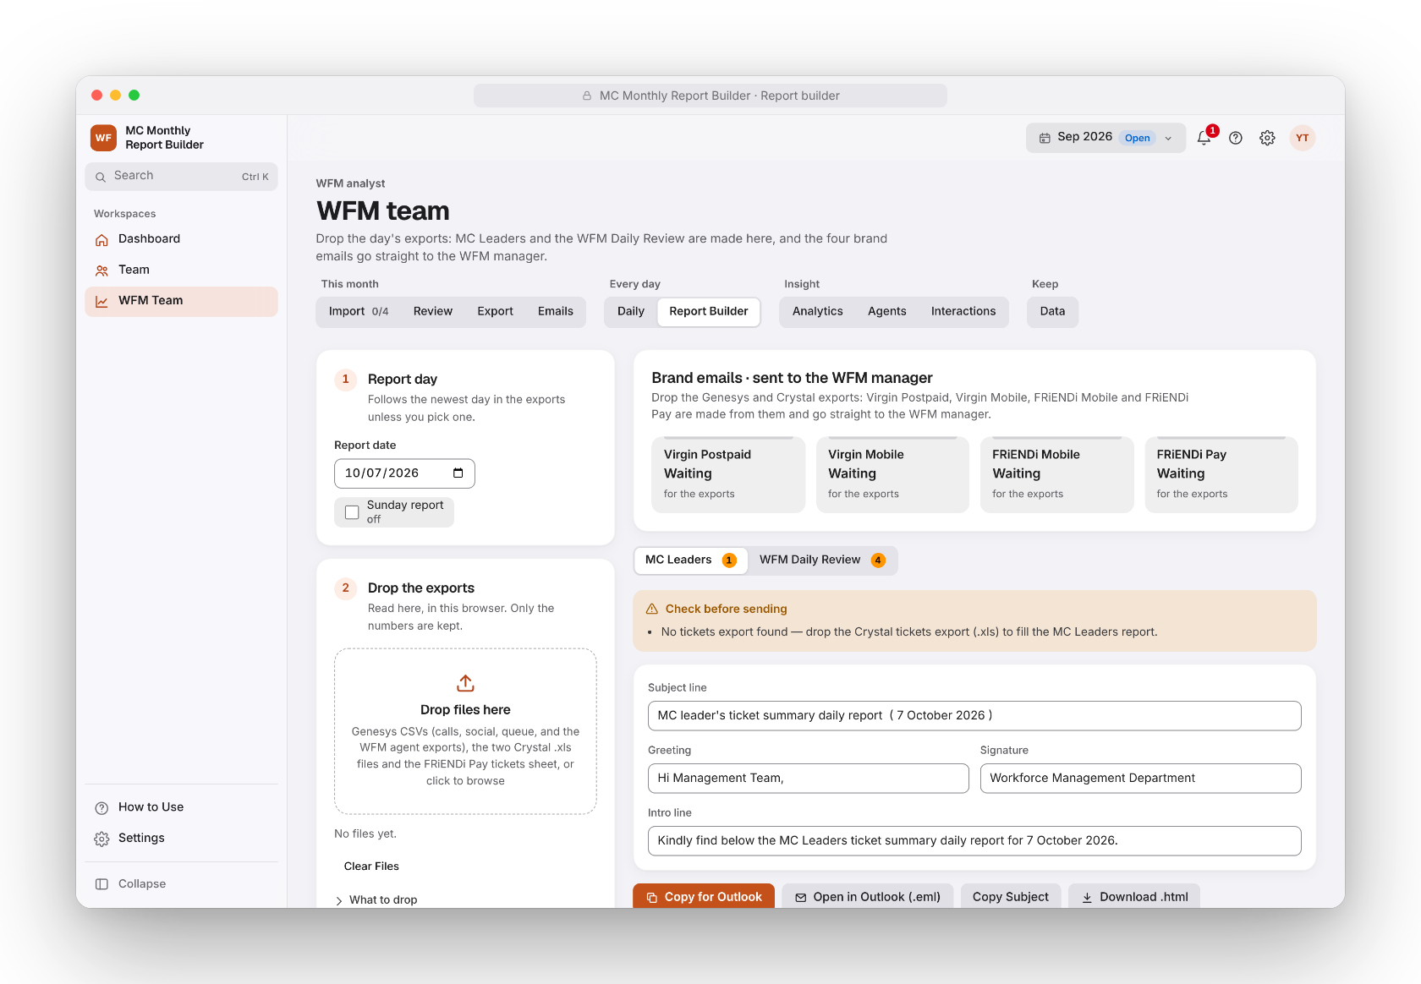


Daily reporting,
built in
EVERY DAY
Drop yesterday's exports
MC Leaders and the WFM Daily Review are made in the tool.
Four brand emails
Virgin Postpaid, Virgin Mobile, FRiENDi Mobile and FRiENDi Pay go straight to the WFM manager to send.
A history that builds itself
Each day is kept, so the month can be followed day by day.
Notes:
Every morning the WFM analysts drop the day's exports: the daily review and the four brand emails are made in the tool and go to the WFM manager to send.

Slide 13



What changes
for Member Care
WHAT IT MEANS
Accuracy
Speed
Transparency
The same rules every month, tested against the previous engine.
The month's files read in one drop; the workbooks and emails built in a click.
Every number explained, every change logged.
Fairness
Accountability
Continuity
The bonus counted the same way for everyone, from one set of rules.
Deadlines and the month close in each person's bell.
Vacation cover, saved uploads and a locked backup: nothing rests on one person.
Notes:
For Member Care this means numbers that are right and explained, a faster month close, the same rules for everyone, clear deadlines, and a process that does not depend on one person.

Slide 14
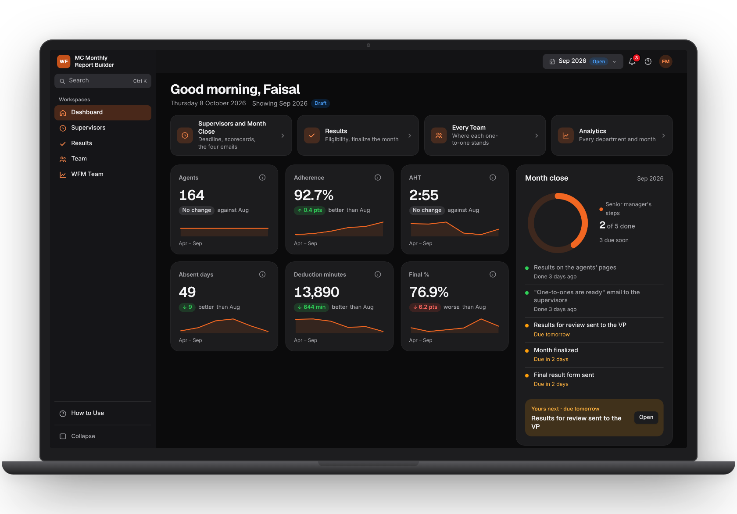
Ready today
Thank you
1
Put the HTML in the common folder, next to the MC Data folder.
2
Open it in Microsoft Edge or Google Chrome.
3
Each person makes an account; the admin gives the roles.
MC Monthly Report Builder · Member Care WFM team
Notes:
The tool is ready today: put the HTML next to the MC Data folder in the common folder, open it in Edge or Chrome, and each person makes an account.

